Slide 2
Library Workshop Welcome!
Sonja Steiner/Martin Weidinger, Librarians
Spring Semester 2024

Slide 3
What we will talk about:
Library facts & rules
How to search our print content online (OPAC)
How to access and search our e-content

Slide 4
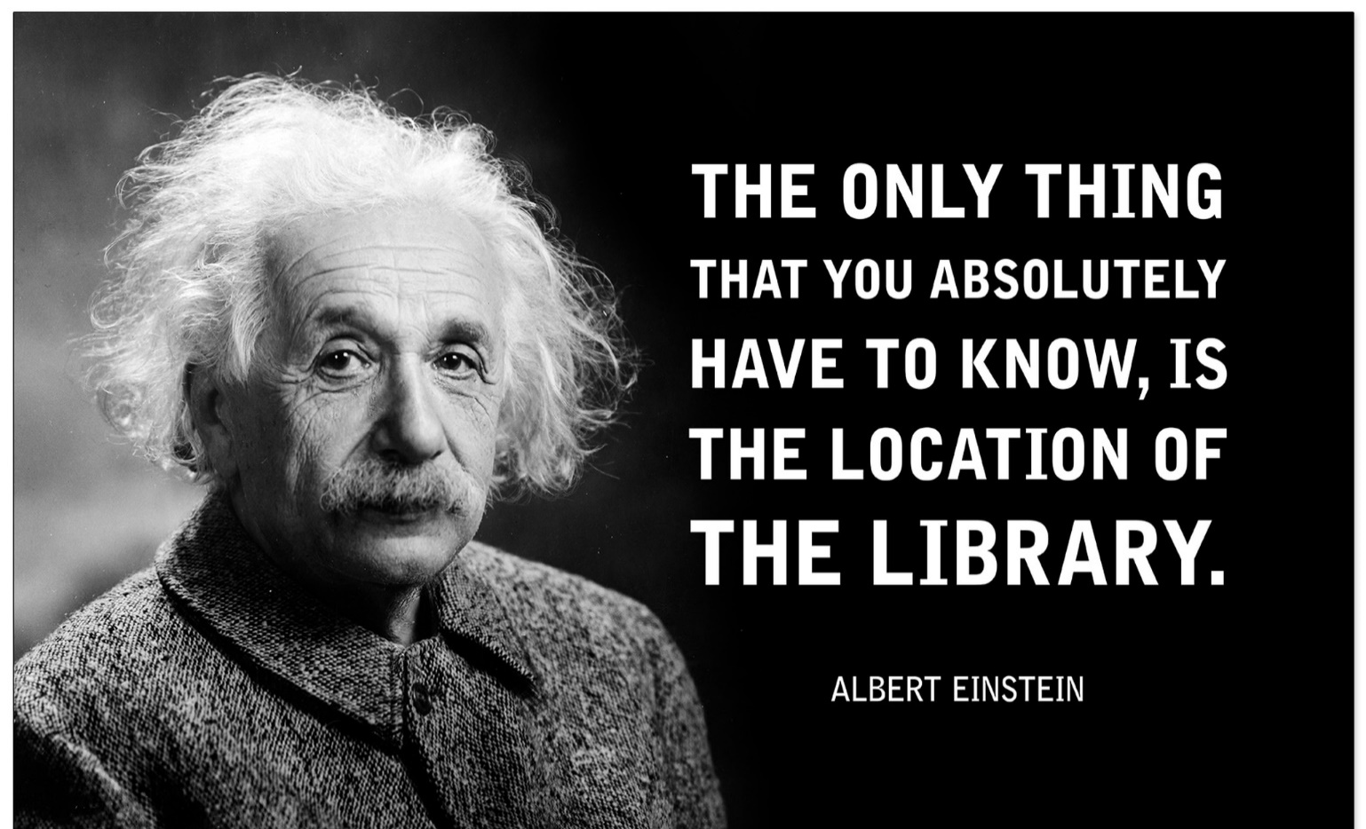
MU Library is located on level 4
Via: www.echo-lit.com

Slide 5
MU Library Facts:
Reference library – books can be used in the library and should mostly stay there
Loans are possible depending on type of book and availability (number of copies etc)

Slide 6
Library … what you get
Library Reading room (Main library room)
Library Work room (Group work)
Copy machine = printer = scanner
3 PC stations
Books / Magazines
eResources
Librarians

Slide 7
Opening Hours
Monday to Thursday: 9:00 A. M. – 6:00 P. M.
Friday: 9:30 A. M. – 5:00 P. M.
Holidays: Shorter opening hours –
please check our website, see the note on the library door, or just email us!
library@modul.ac.at

Slide 8
Library Rules
Please DO...
... turn off your phone
… speak in a low voice and avoid
any unnecessary noise
Please DO NOT...
... eat or drink in the library
... damage books

Slide 9
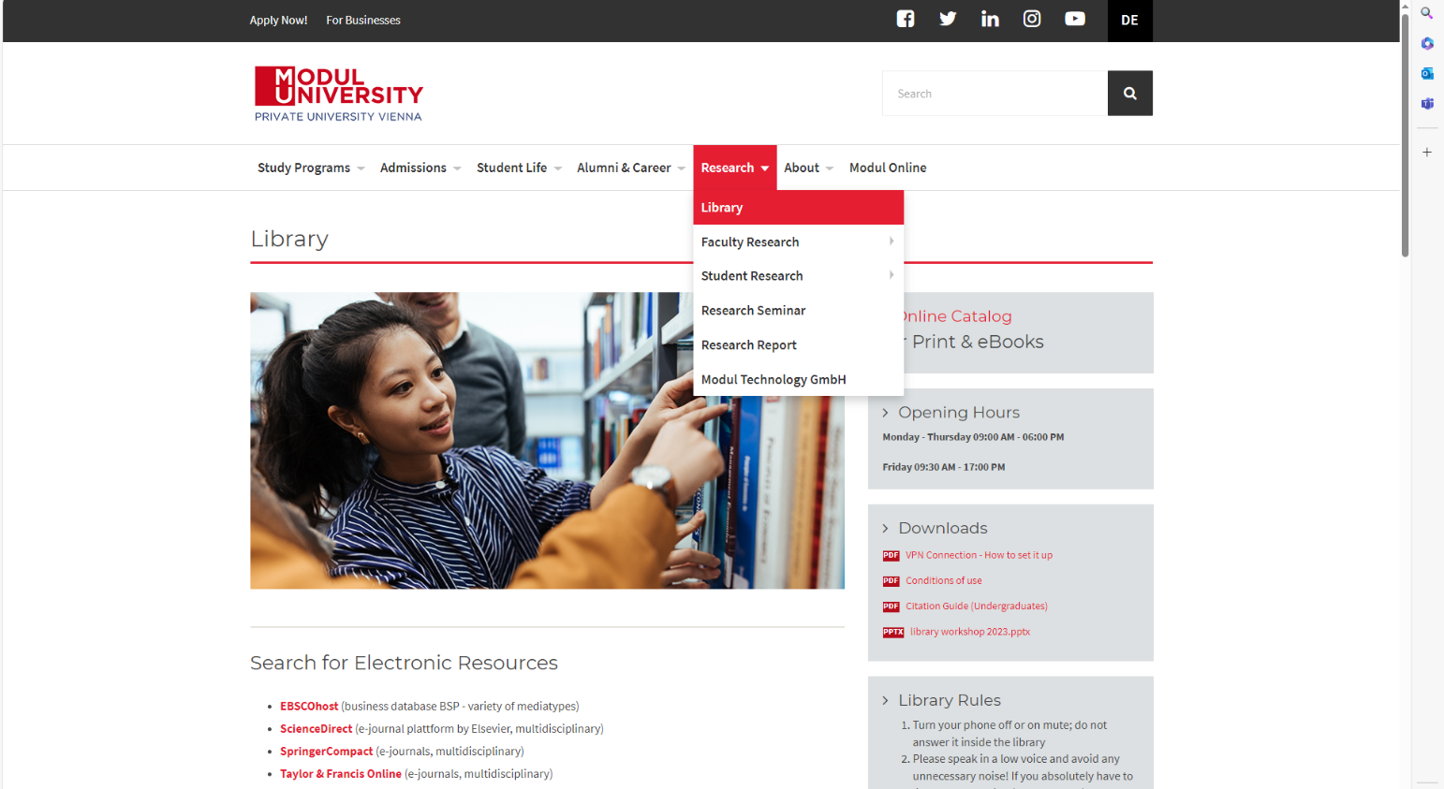
How to find the books you need:

Slide 10
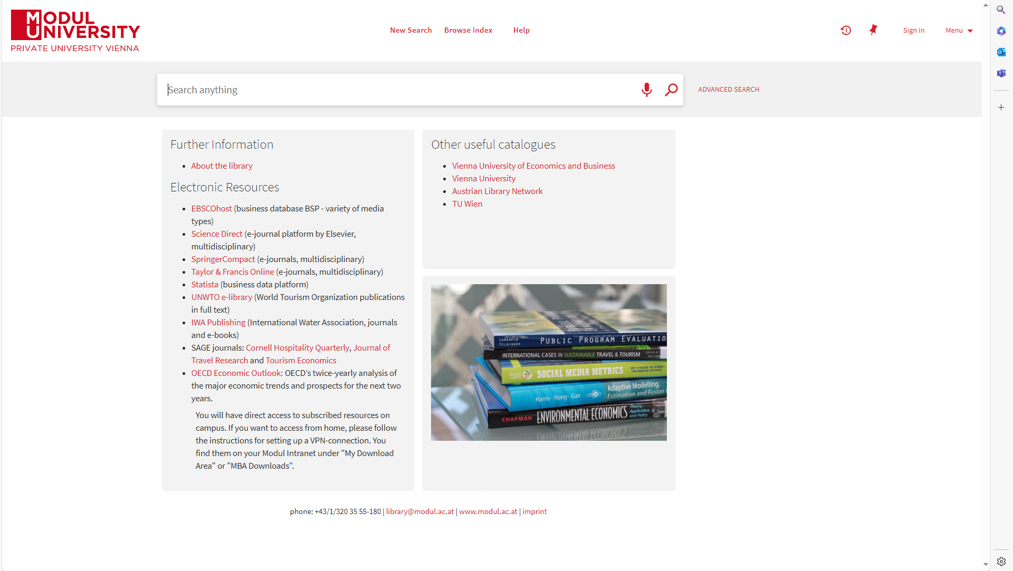
Online Catalogue

Slide 11
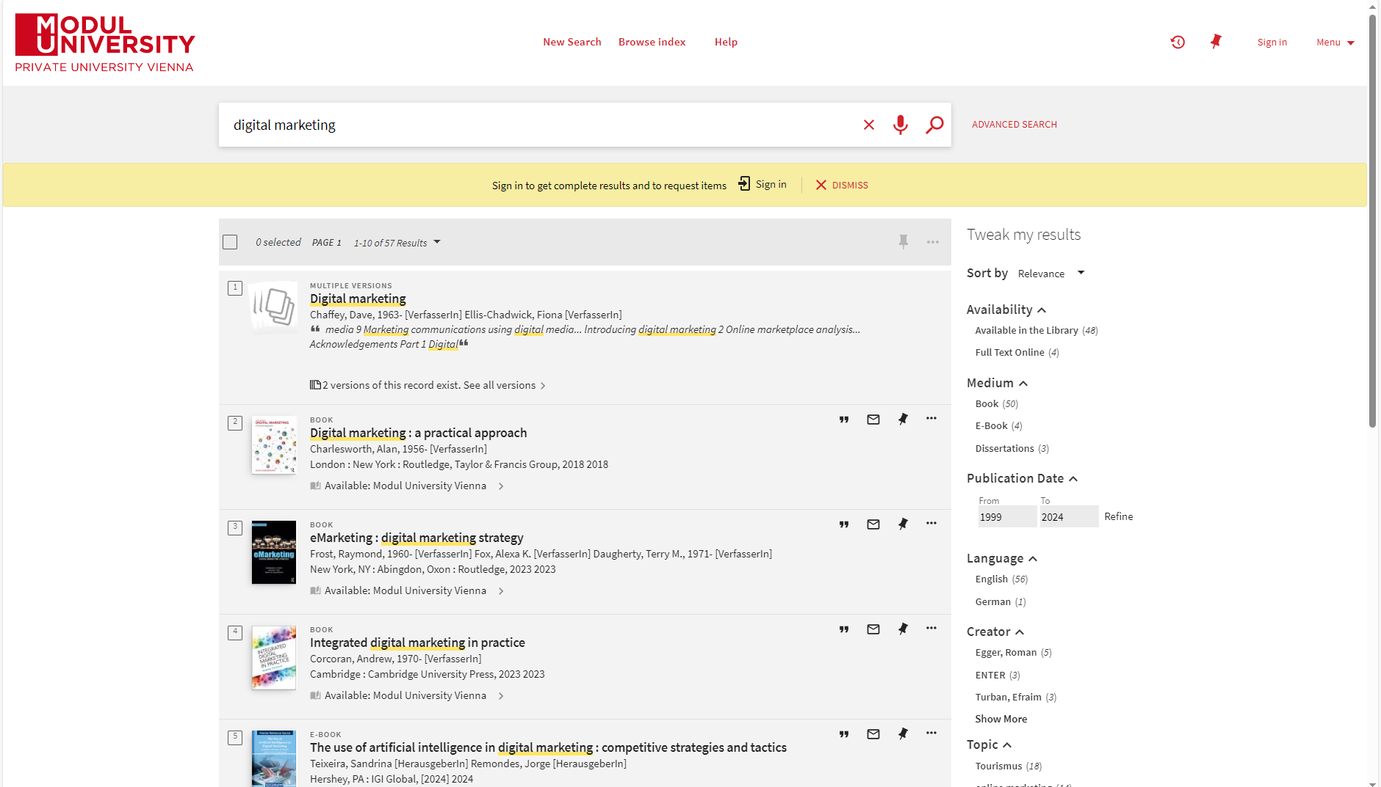
Easy Search

Slide 12
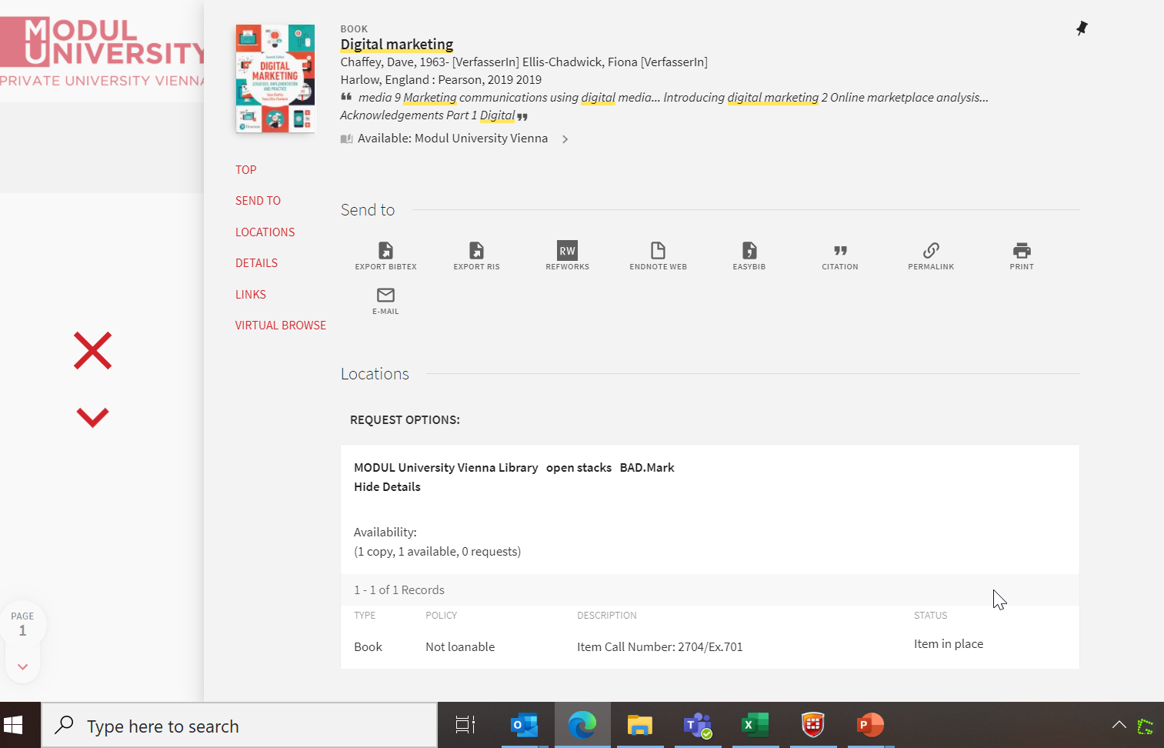
You found the book!
The shelf where you can find the book
Is the book available at the moment?
The number on the spine of the book

Slide 13
Check out the book
Now you can
… use the book in the library
… check out the book at the librarians‘ desk

Slide 14
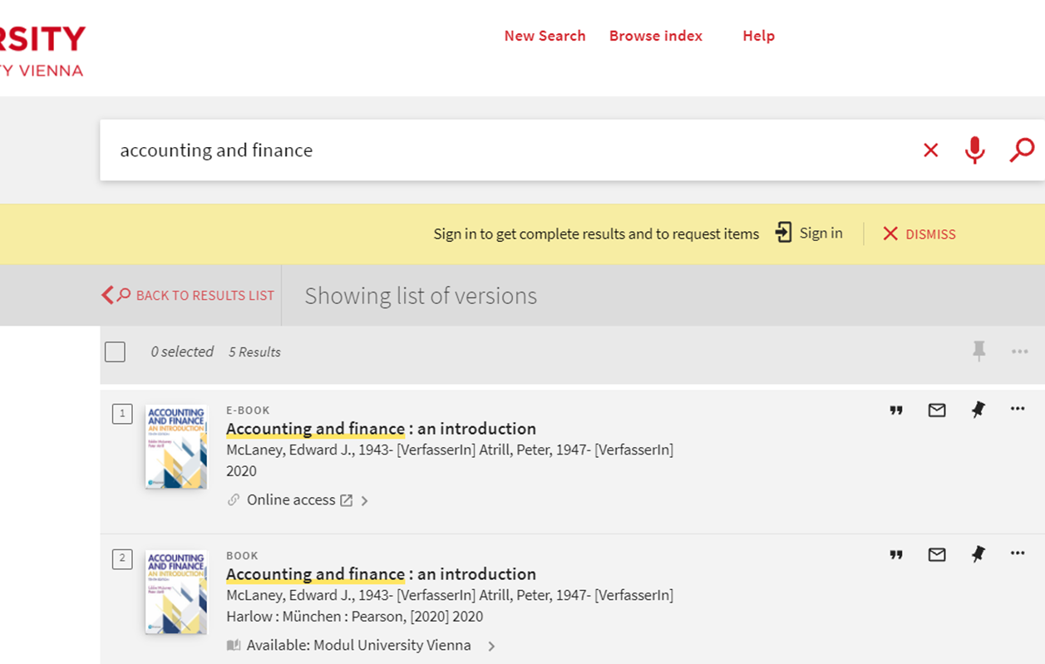
eBooks

Slide 15
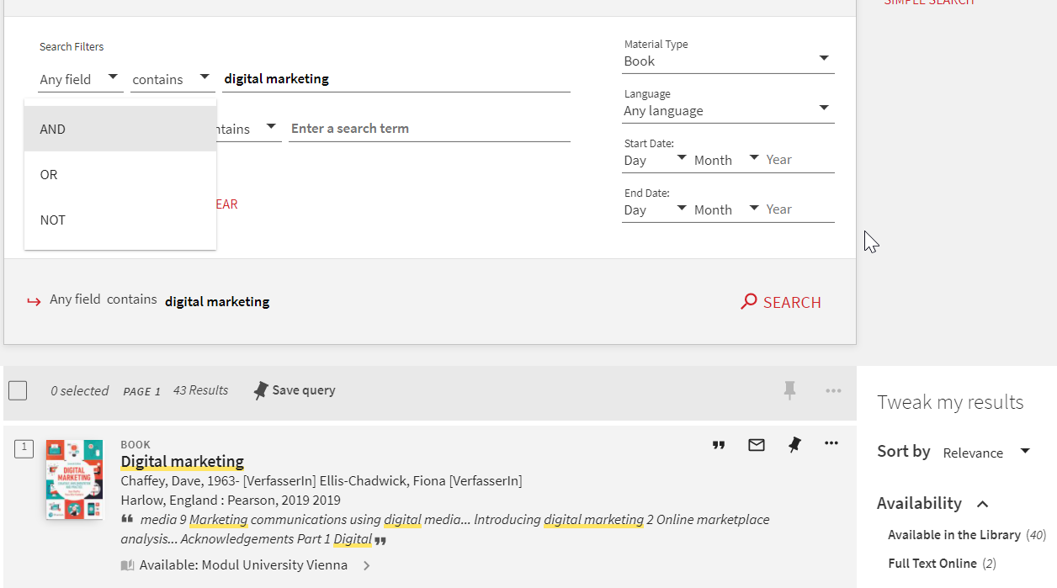
Advanced Search
Boolian operators

Slide 16
Boolean Operators
Boolean logic is about relationships between entities:
AND each citation contains ALL the search terms = less results
(e.g. marketing AND management = hits include BOTH terms)
OR you will find documents that contain AT LEAST ONE of the specified search terms = more results
(e.g. marketing OR management = hits include either term)
NOT you EXCLUDE terms from your search = less results
(e.g. marketing NOT management = hits that include marketing only when it doesn‘t include management)
Be careful what you exclude so you don‘t lose valuable hits!

Slide 17
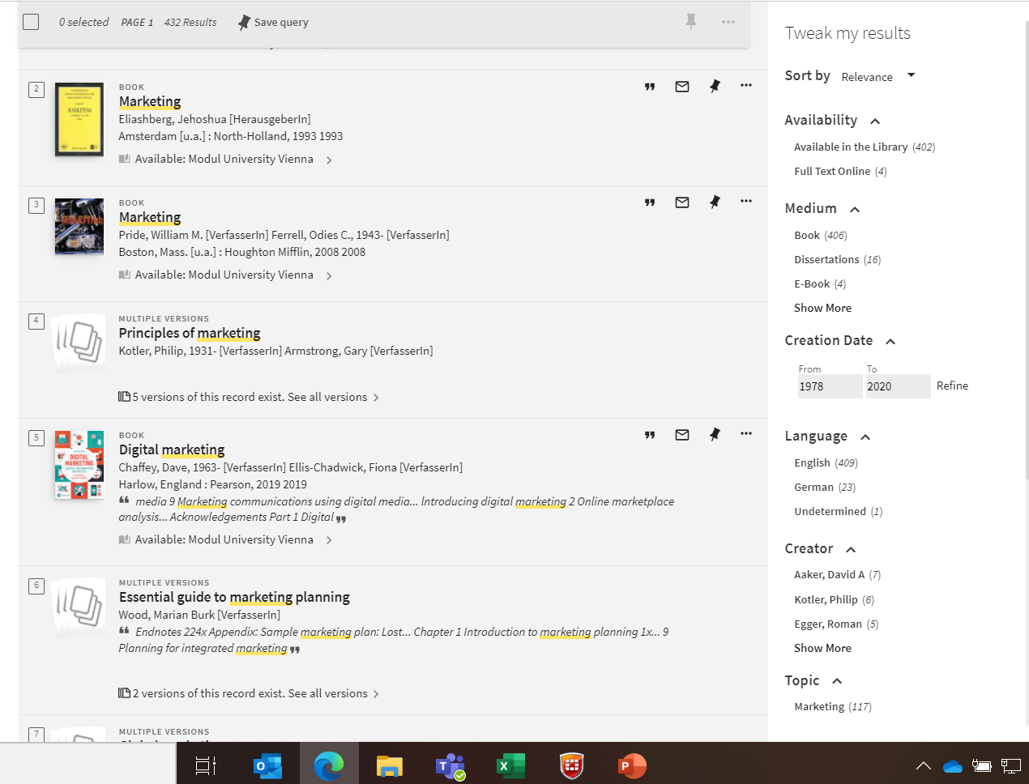
Refine
Refining Options

Slide 18
Electronic content
A few key terms
Access to our electronic resources
What these resources contain and
How to search in them

Slide 19
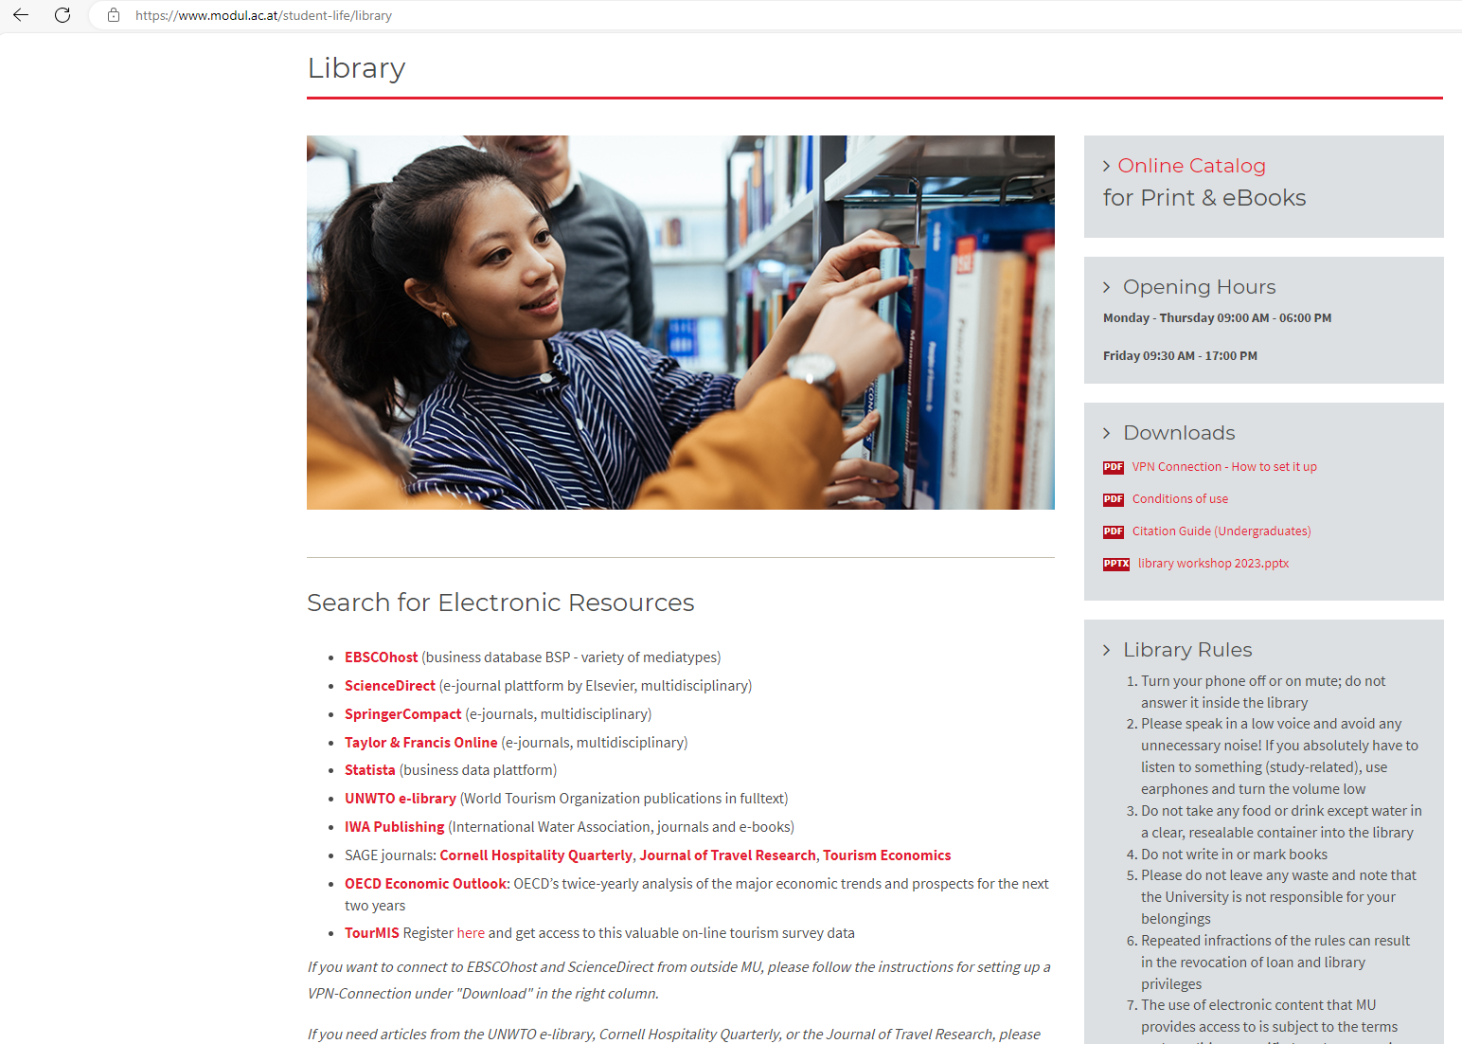
Access to all of MU‘s electronic resources
Find the links on the Library homepage

Slide 20
Access to all of MU‘s electronic resources:
Find the links on the library website
On campus: no need to log in
Off campus: via VPN connection (see “download area” on the library website for details)

Slide 21
EBSCO host – Business Source Premier
EBSCO Business Source Premier is a widely used business research database that includes bibliographical data, E-Books, full-text articles, market studies, reports on countries, companies, and sectors. It also includes SWOT Analyses.

Slide 22
Science Direct
SD is a platform of peer-reviewed scholarly literature containing material of only one publisher, Elsevier.
You can use it to get full text articles from journals we have subscribed to or from Open Access Journals, or you can also use it as a reference platform to see what other articles might be interesting for you.

Slide 23
Springer
Springer is a platform of scholarly literature containing material of only one publisher, Springer.
You can use it to get full text articles from journals we have subscribed to or from Open Access Journals, or you can also use it as a reference platform to see what other articles might be interesting for you.

Slide 24
UNWTO E-Library
The UNWTO Elibrary is an online service from the World Tourism Organization (UNWTO) with a broad coverage of tourism and related subject areas.
You find books, journals, statistics, reports… all things tourism. The subject areas include, among other, ecotourism, sustainable development, finance and investment, risk and crisis management, market research, tourism statistics and poverty alleviation.

Slide 25
Statista
Statista is one of the biggest statistics databases offering information from market- and opinion research institutes, official statistics, economic data.
Their range of topics and industries is extremely broad, covering tourism as well as coronavirus, coal mining, the film industry and almost anything in between.

Slide 26
Taylor & Francis Online
Large number of journals and articles
T&F social sciences and humanities library
T&F science and technology library

Slide 27
Questions?
Please do not hesitate to contact your library team if you have any questions!
Let us know if we can help you with using the online resources or our own library OPAC (=the online catalogue) – we will try our best to support you!
library@modul.ac.at

Slide 28
Thank you for your attention!
Contact:
library@modul.ac.at

